Slide 1

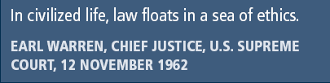
Principles of Information Security,
Fifth Edition
Chapter 3
Legal, Ethical, and Professional
Issues in Information Security

Slide 2
Learning Objectives
Upon completion of this material, you should be able to:
  Describe the functions of and relationships among laws, regulations, and professional organizations in information security
  Explain the differences between laws and ethics
  Identify major national laws that affect the practice of information security
  Discuss the role of culture as it applies to ethics in information security
Principles of Information Security, Fifth Edition
Notes:
Learning Objectives
Upon completion of this material, you should be able to:
Describe the functions of and relationships among laws, regulations, and professional organizations in information security
Explain the differences between laws and ethics
Identify major national laws that affect the practice of information security
Discuss the role of culture as it applies to ethics in information security

Slide 3
Introduction
You must understand the scope of an organization’s legal and ethical responsibilities.
To minimize liabilities/reduce risks, the information security practitioner must:
  Understand the current legal environment
  Stay current with laws and regulations
  Watch for new and emerging issues
Principles of Information Security, Fifth Edition
Notes:
Introduction
You must understand scope of an organization’s legal and ethical responsibilities
To minimize liabilities/reduce risks, the information security practitioner must:
Understand current legal environment
Stay current with laws and regulations
Watch for new and emerging issues
.

Slide 4
Law and Ethics in Information Security
Laws: rules that mandate or prohibit certain behavior and are enforced by the state
Ethics: regulate and define socially acceptable behavior
Cultural mores: fixed moral attitudes or customs of a particular group
Laws carry the authority of a governing authority; ethics do not.
Principles of Information Security, Fifth Edition
Notes:
Law and Ethics in Information Security
Laws: rules that mandate or prohibit certain behavior and are enforced by the state
Ethics: regulate and define socially acceptable behavior
Cultural mores: fixed moral attitudes or customs of a particular group
Laws carry authority of a governing authority; ethics do not

Slide 5
Organizational Liability and the Need for Counsel
Liability: the legal obligation of an entity extending beyond criminal or contract law; includes the legal obligation to make restitution
Restitution: the legal obligation to compensate an injured party for wrongs committed
Due care: the legal standard requiring a prudent organization to act legally and ethically and know the consequences of actions
Due diligence: the legal standard requiring a prudent organization to maintain the standard of due care and ensure actions are effective
Principles of Information Security, Fifth Edition
Notes:
Organizational Liability and the Need for Counsel
Liability: legal obligation of an entity extending beyond criminal or contract law; includes legal obligation to make restitution
Restitution: legal obligation to compensate injured party for wrongs committed
Due care: legal standard requiring prudent organization to act legally and ethically and know consequences of actions
Due diligence: legal standard requiring prudent organization to maintain standard of due care and ensure actions are effective

Slide 6
Organizational Liability and the Need for Counsel (cont’d)‏
Jurisdiction: court’s right to hear a case if the wrong was committed in its territory or involved its citizenry
Long-arm jurisdiction: application of laws to those residing outside a court’s normal jurisdiction; usually granted when a person acts illegally within the jurisdiction and leaves
Principles of Information Security, Fifth Edition
Notes:
Organizational Liability and the Need for Counsel
Jurisdiction: court's right to hear a case if the wrong was committed in its territory or involved its citizenry
Long arm jurisdiction: application of laws to those residing outside court’s normal jurisdiction; usually granted when person acts illegally within jurisdiction and leaves

Slide 7
Policy Versus Law
Policies: managerial directives that specify acceptable and unacceptable employee behavior in the workplace
Policies function as organizational laws; must be crafted and implemented with care to ensure they are complete, appropriate, and fairly applied to everyone
Difference between policy and law: Ignorance of a policy is an acceptable defense.
Principles of Information Security, Fifth Edition
Notes:
Policy Versus Law
Policies: managerial directives that specify acceptable and unacceptable employee behavior in the workplace
Policies function as organizational laws; must be crafted and implemented with care to ensure they are complete, appropriate, and fairly applied to everyone
Difference between policy and law: ignorance of a policy is an acceptable defense

Slide 8
Policy Versus Law (cont’d)
Criteria for policy enforcement:
  Dissemination (distribution)
  Review (reading)
  Comprehension (understanding)
  Compliance (agreement)
  Uniform enforcement
Principles of Information Security, Fifth Edition
Notes:
Policy Versus Law
Criteria for policy enforcement:
Dissemination (distribution)
Review (reading)
Comprehension (understanding)
Compliance (agreement)
Uniform enforcement

Slide 9
Types of Law
Civil: governs nation or state; manages relationships/conflicts between organizations and people
Criminal: addresses activities and conduct harmful to society; actively enforced by the state
Private: family/commercial/labor law; regulates relationships between individuals and organizations
Public: regulates structure/administration of government agencies and their relationships with citizens, employees, and other governments
Principles of Information Security, Fifth Edition
Notes:
Types of Law
Civil: governs nation or state; manages relationships/conflicts between organizations and people
Criminal: addresses activities and conduct harmful to society; actively enforced by the state
Private: family/commercial/labor law; regulates relationships between individuals and organizations
Public: regulates structure/administration of government agencies and relationships with citizens, employees, and other governments

Slide 10
Relevant U.S. Laws
The United States has been a leader in the development and implementation of information security legislation.
Information security legislation contributes to a more reliable business environment and a stable economy.
The United States has demonstrated understanding of the importance of securing information and has specified penalties for individuals and organizations that breach civil and criminal law.
Principles of Information Security, Fifth Edition
Notes:
Relevant US Laws
United States has been a leader in the development and implementation of information security legislation
Information security legislation contributes to a more reliable business environment and a stable economy
U.S. has demonstrated understanding of importance of securing information; has specified penalties for individuals and organizations that breach civil and criminal law

Slide 11
General Computer Crime Laws
Computer Fraud and Abuse Act of 1986 (CFA Act): Cornerstone of many computer-related federal laws and enforcement efforts‏
National Information Infrastructure Protection Act of 1996:
  Modified several sections of the previous act and increased the penalties for selected crimes
  Severity of the penalties was judged on the value of the information and the purpose
    For purposes of commercial advantage
    For private financial gain
    In furtherance of a criminal act
Principles of Information Security, Fifth Edition
Notes:
Relevant U.S. Laws - General Computer Crime Laws
Computer Fraud and Abuse Act of 1986 (CFA Act): cornerstone of many computer-related federal laws and enforcement efforts‏
National Information Infrastructure Protection Act of 1996:
Modified several sections of the previous act and increased the penalties for selected crimes
Severity of penalties judged on value of information and the purpose
For purposes of commercial advantage
For private financial gain
In furtherance of a criminal act

Slide 12
General Computer Crime Laws (cont’d)
USA PATRIOT Act of 2001: Provides law enforcement agencies with broader latitude in order to combat terrorism-related activities
USA PATRIOT Improvement and Reauthorization Act: Made permanent fourteen of the sixteen expanded powers of the Department of Homeland Security and the FBI in investigating terrorist activity
Computer Security Act of 1987: One of the first attempts to protect federal computer systems by establishing minimum acceptable security practices.
Principles of Information Security, Fifth Edition
Notes:
General Computer Crime Laws
USA PATRIOT Act of 2001: provides law enforcement agencies with broader latitude in order to combat terrorism-related activities
USA PATRIOT Improvement and Reauthorization Act: made permanent fourteen of the sixteen expanded powers of the Department of Homeland Security and the FBI in investigating terrorist activity
Computer Security Act of 1987: one of the first attempts to protect federal computer systems by establishing minimum acceptable security practices

Slide 13
Privacy
One of the hottest topics in information security
Right of individuals or groups to protect themselves and personal information from unauthorized access
Ability to aggregate data from multiple sources allows creation of information databases previously impossible
The number of statutes addressing an individual’s right to privacy has grown.
Principles of Information Security, Fifth Edition
Notes:
Privacy
The issue of privacy has become one of the hottest topics in information.
The ability to collect information on an individual, combine facts from separate sources, and merge it with other information has resulted in databases of information that were previously impossible to set up.
The aggregation of data from multiple sources permits unethical organizations to build databases of facts with frightening capabilities.

Slide 14
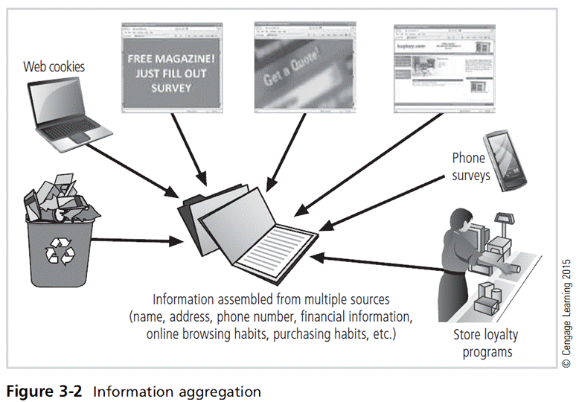
Principles of Information Security, Fifth Edition

Slide 15
Privacy (cont’d)
U.S. Regulations
  Privacy of Customer Information Section of the common carrier regulation
  Federal Privacy Act of 1974
  Electronic Communications Privacy Act of 1986
  Health Insurance Portability and Accountability Act of 1996 (HIPAA), aka Kennedy-Kassebaum Act
  Financial Services Modernization Act, or Gramm-Leach-Bliley Act of 1999
Principles of Information Security, Fifth Edition
Notes:
Privacy of Customer Information
The Privacy of Customer Information Section of Common Carrier regulation specifies that any proprietary information shall be used explicitly for providing services, and not for any marketing purposes.
It also stipulates that carriers cannot disclose this information except when necessary to provide their services.
The only other exception is when a customer requests the disclosure of information, and then the disclosure is restricted to that customer’s information only.
The Federal Privacy Act of 1974 regulates the government in the protection of individual privacy and was created to insure that government agencies protect the privacy of individuals’ and businesses’ information and to hold those agencies responsible if any portion of this information is released without permission.
The Electronic Communications Privacy Act of 1986 regulates the interception of wire, electronic, and oral communications. The ECPA works in conjunction with the Fourth Amendment of the US Constitution, which provides protections from unlawful search and seizure.
The Health Insurance Portability & Accountability Act Of 1996 (HIPAA), also known as the Kennedy-Kassebaum Act, impacts all health-care organizations including small doctor practices, health clinics, life insurers and universities, as well as some organizations which have self-insured employee health programs.
The act requires organizations that retain health-care information to use information security mechanisms to protect this information, as well as policies and procedures to maintain this security.
It also requires a comprehensive assessment of the organization's information security systems, policies, and procedures.
There is no specification of particular security technologies for each of the security requirements; only that security must be implemented to ensure the privacy of the health-care information.
The privacy standards of HIPAA severely restrict the dissemination and distribution of private health information without documented consent.
The standards provide patients the right to know who has access to their information and who has accessed it and also restrict the use of health information to the minimum required for the healthcare services required.
The Financial Services Modernization Act or Gramm-Leach-Bliley Act of 1999 requires all financial institutions to disclose their privacy policies on the sharing of nonpublic personal information.
It also requires due notice to customers so that they can request that their information not be shared with third parties.
The act ensures that the privacy policies in effect in an organization are fully disclosed when a customer initiates a business relationship, as well as distributed at least annually for the duration of the professional association.

Slide 16
Identity Theft
It can occur when someone steals victim’s personally identifiable information (PII) and poses as victim to conduct actions/make purchases.
Federal Trade Commission oversees efforts to foster coordination, effective prosecution of criminals, and methods to increase victim’s restitution.
Fraud and Related Activity in Connection with Identification Documents, Authentication Features, and Information (Title 18, U.S.C. § 1028)‏
Principles of Information Security, Fifth Edition
Notes:
Identity Theft
Can occur when someone steals victim’s personally identifiable information (PII) and poses as victim to conduct actions/make purchases
Federal Trade Commission oversees efforts to foster coordination, effective prosecution of criminals, and methods to increase victim’s restitution
Fraud and Related Activity in Connection with Identification Documents, Authentication Features, and Information (Title 18, U.S.C. § 1028)‏

Slide 17
Identity Theft (cont’d)
If someone suspects identity theft:
  Report to one of the three national credit reporting companies and request initial fraud alert.
  Order credit reports and examine for fraud activity; contact the fraud department in the organization holding the suspect account.
  Create an identity theft report through FTC’s identity theft affidavit.
  Document all calls/letters/communications during the process.
Principles of Information Security, Fifth Edition
Notes:
Identity Theft
If someone suspects identity theft
Report to one of three national credit reporting companies and request initial fraud alert
Order credit reports and examine for fraud activity; contact fraud department in organization holding suspect account
Create identity theft report through FTC’s identity theft affidavit
Document all calls/letters/communications during the process

Slide 18
Export and Espionage Laws
Economic Espionage Act of 1996 (EEA)‏
Security and Freedom through Encryption Act of 1999 (SAFE)‏
The acts include provisions about encryption that:
  Reinforce the right to use or sell encryption algorithms, without concern of key registration.
  Prohibit the federal government from requiring it.
  Make it not probable cause to suspect criminal activity.
  Relax export restrictions.
  Additional penalties for using it in a crime.
Principles of Information Security, Fifth Edition
Notes:
Export And Espionage Laws
In an attempt to protect American ingenuity, intellectual property, and competitive advantage, Congress passed the Economic Espionage Act (EEA) in 1996. This law attempts to prevent trade secrets from being illegally shared.
The Security And Freedom Through Encryption Act of 1997 (SAFE) was an attempt by Congress to provide guidance on the use of encryption and provided measures of public protection from government intervention.

Slide 19
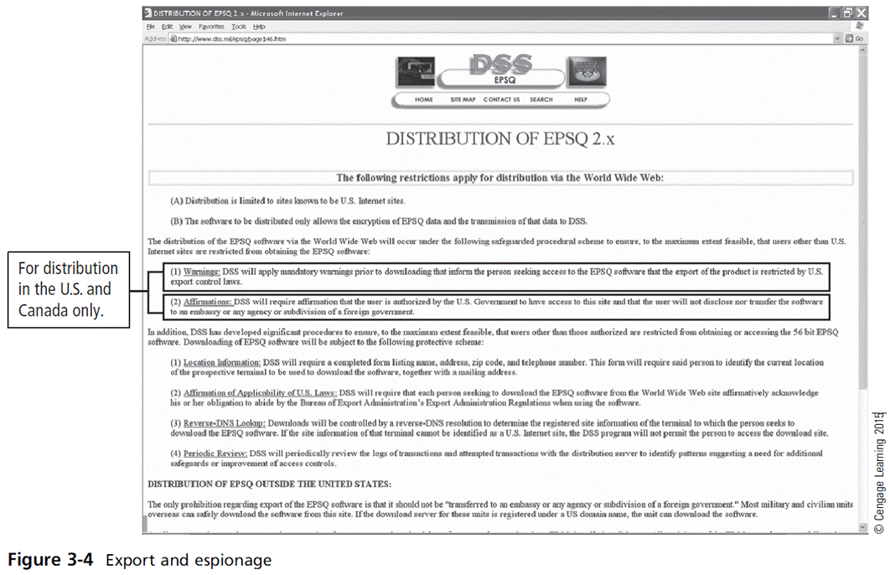
Principles of Information Security, Fifth Edition

Slide 20
U.S. Copyright Law
Intellectual property was recognized as a protected asset in the United States; copyright law extends to electronic formats.
With proper acknowledgment, it is permissible to include portions of others’ work as reference.
U.S. Copyright Office Web site: www.copyright.gov
Principles of Information Security, Fifth Edition
Notes:
U.S. Copyright Law
Intellectual property is recognized as a protected asset in the U.S. U.S. copyright law extends this right to the published word, including electronic formats.
Fair use of copyrighted materials includes the use to support news reporting, teaching, scholarship, and a number of other related permissions, so long as the purpose of the use is for educational or library purposes, not for profit, and is not excessive.

Slide 21
Financial Reporting
Sarbanes-Oxley Act of 2002
Affects the executive management of publicly traded corporations and public accounting firms
Seeks to improve the reliability and accuracy of financial reporting and increase the accountability of corporate governance in publicly traded companies
Penalties for noncompliance range from fines to jail terms.
Principles of Information Security, Fifth Edition
Notes:
Financial Reporting
Sarbanes-Oxley Act of 2002
Affects executive management of publicly traded corporations and public accounting firms
Seeks to improve reliability and accuracy of financial reporting and increase the accountability of corporate governance in publicly traded companies
Penalties for noncompliance range from fines to jail terms

Slide 22
Freedom of Information Act of 1966 (FOIA)
Allows access to federal agency records or information not determined to be matter of national security
U.S. government agencies are required to disclose any requested information upon receipt of written request.
Some information is protected from disclosure; this act does not apply to state/local government agencies or private businesses/individuals.
Principles of Information Security, Fifth Edition
Notes:
Freedom of Information Act of 1966 (FOIA)
Allows access to federal agency records or information not determined to be matter of national security
U.S. government agencies required to disclose any requested information upon receipt of written request
Some information protected from disclosure; does not apply to state/local government agencies or private businesses/individuals

Slide 23
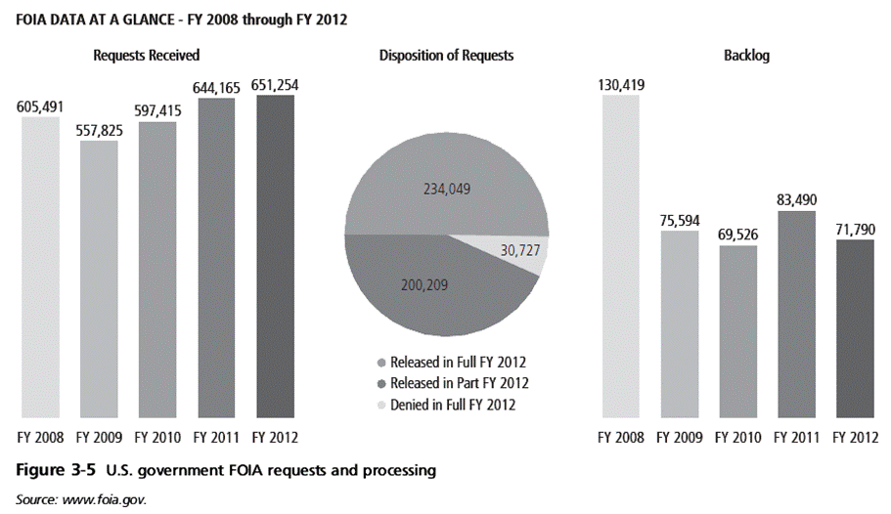
Principles of Information Security, Fifth Edition

Slide 24
Payment Card Industry Data Security Standards (PCI DSS)
PCI Security Standards Council offers a standard of performance to which organizations processing payment cards must comply.
Designed to enhance security of customer’s account data
Addresses six areas:
  Build and maintain secure networks/systems
  Protect cardholder data
  Maintain vulnerability management program
  Implement strong access control measures
  Regularly monitor and test networks
  Maintain information security policy
Principles of Information Security, Fifth Edition
Notes:
PCI DSS
PCI Security Standards Council offers standard of performance to which organizations processing payment cards must comply
Designed to enhance security of customer’s account data
Addresses six areas:
Build and maintain secure networks/systems
Protect cardholder data
Maintain vulnerability management program
Implement strong access control measures
Regularly monitor and test networks
Maintain information security policy

Slide 25
State and Local Regulations
Federal computer laws are mainly written specifically for federal information systems; they have little applicability to private organizations.
Information security professionals are responsible for understanding state regulations and ensuring that organization is in compliance with regulations.
Principles of Information Security, Fifth Edition
Notes:
State & Local Regulations
Federal computer laws mainly written specifically for federal information systems; have little applicability to private organizations
Information security professional responsible for understanding state regulations and ensuring organization is compliant with regulations

Slide 26
International Laws and Legal Bodies
When organizations do business on the Internet, they do business globally.
Professionals must be sensitive to the laws and ethical values of many different cultures, societies, and countries.
Because of the political complexities of relationships among nations and differences in culture, few international laws cover privacy and information security.
These international laws are important but are limited in their enforceability.
Principles of Information Security, Fifth Edition
Notes:
International Laws and Legal Bodies
When organizations do business on the Internet, they do business globally
Professionals must be sensitive to laws and ethical values of many different cultures, societies, and countries
Because of political complexities of relationships among nations and differences in culture, few international laws cover privacy and information security
These international laws are important but are limited in their enforceability

Slide 27
Council of Europe Convention on Cybercrime
Created international task force to oversee Internet security functions for standardized international technology laws
Attempts to improve effectiveness of international investigations into breaches of technology law
Well received by intellectual property rights advocates due to emphasis on copyright infringement prosecution
Lacks realistic provisions for enforcement
Principles of Information Security, Fifth Edition
Notes:
International Laws and Legal Bodies
Recently the Council of Europe drafted the European Council Cyber-Crime Convention, designed to create an international task force to oversee a range of security functions associated with Internet activities and to standardize technology laws across international borders.
It also attempts to improve the effectiveness of international investigations into breaches of technology law.
This convention is well received by advocates of intellectual property rights with its emphasis on copyright infringement prosecution.

Slide 28
Agreement on Trade-Related Aspects of Intellectual Property Rights
Created by World Trade Organization (WTO)
The first significant international effort to protect intellectual property rights
Outlines requirements for governmental oversight and legislation providing minimum levels of protection for intellectual property
Principles of Information Security, Fifth Edition
Notes:
Agreement on Trade-Related Aspects of Intellectual Property Rights
Created by World Trade Organization (WTO)
First significant international effort to protect intellectual property rights
Outlines requirements for governmental oversight and legislation providing minimum levels of protection for intellectual property

Slide 29
Agreement on Trade-Related Aspects of Intellectual Property Rights (cont’d)
Agreement covers five issues:
  Application of basic principles of trading system and international intellectual property agreements
  Giving adequate protection to intellectual property rights
  Enforcement of those rights by countries within their borders
  Settling intellectual property disputes
  Transitional arrangements while new system is being introduced
Principles of Information Security, Fifth Edition

Slide 30
Digital Millennium Copyright Act (DMCA)‏
U.S. contribution to international effort to reduce impact of copyright, trademark, and privacy infringement
A response to European Union Directive 95/46/EC
Prohibits
  Circumvention of protections and countermeasures
  Manufacture and trafficking of devices used to circumvent such protections
  Altering information attached or imbedded in copyrighted material
Excludes ISPs from some copyright infringement
Principles of Information Security, Fifth Edition
Notes:
Digital Millennium Copyright Act (DMCA)‏
The Digital Millennium Copyright Act (DMCA) is the U.S. version of an international effort to reduce the impact of copyright, trademark, and privacy infringement especially through the removal of technological copyright protection measures.
The European Union also put forward Directive 95/46/EC that increases protection of individuals with regard to the processing of personal data and the free movement of such data.
The United Kingdom has already implemented a version of this directive called the Database Right.

Slide 31
Ethics and Information Security
Many professional disciplines have explicit rules governing the ethical behavior of members.
IT and IT security do not have binding codes of ethics.
Professional associations and certification agencies work to maintain ethical codes of conduct.
  Can prescribe ethical conduct
  Do not always have the ability to ban violators from practice in field
Principles of Information Security, Fifth Edition
Notes:
Ethics and Information Security
Many professional disciplines have explicit rules governing ethical behavior of members
IT and IT security do not have binding codes of ethics
Professional associations and certification agencies work to maintain ethical codes of conduct
Can prescribe ethical conduct
Do not always have the ability to ban violators from practice in field

Slide 32
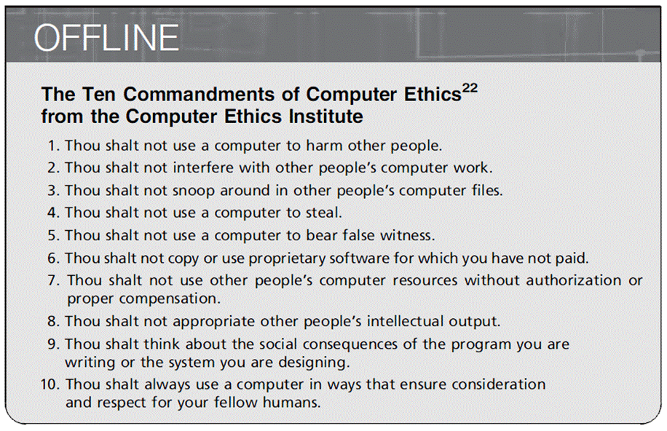
Principles of Information Security, Fifth Edition
Notes:
Ethical Concepts in Information Security
“The Ten Commandments of Computer Ethics from The Computer Ethics Institute
1. Thou shalt not use a computer to harm other people.
2. Thou shalt not interfere with other people's computer work.
3. Thou shalt not snoop around in other people's computer files.
4. Thou shalt not use a computer to steal.
5. Thou shalt not use a computer to bear false witness.
6. Thou shalt not copy or use proprietary software for which you have not paid.
7. Thou shalt not use other people's computer resources without authorization or proper compensation.
8. Thou shalt not appropriate other people's intellectual output.
9. Thou shalt think about the social consequences of the program you are writing or the system you are designing.
10. Thou shalt always use a computer in ways that insure consideration and respect for your fellow humans.”

Slide 33
Ethical Differences Across Cultures
Cultural differences create difficulty in determining what is and is not ethical.
Difficulties arise when one nationality’s ethical behavior conflicts with the ethics of another national group.
Scenarios are grouped into:
  Software license infringement
  Illicit use
  Misuse of corporate resources
Cultures have different views on the scenarios.
Principles of Information Security, Fifth Edition
Notes:
Cultural Differences in Ethical Concepts
With regard to computer use, differences in cultures cause problems in determining what is ethical and what is not ethical.
Studies of ethical sensitivity to computer use reveal that individuals of different nationalities have different perspectives on ethics.
Difficulties arise when one nationality’s ethical behavior contradicts that of another national group.

Slide 34
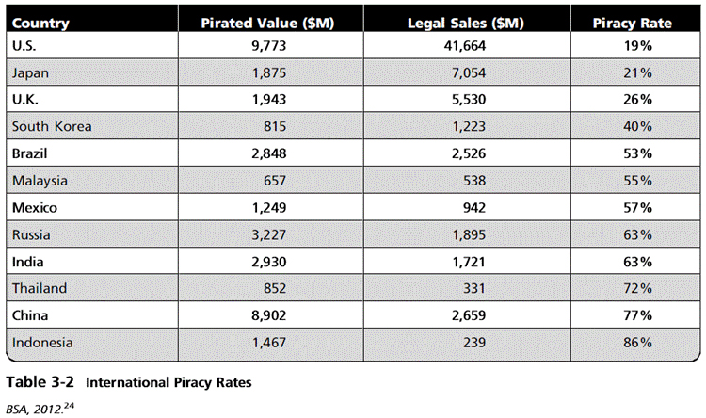
Principles of Information Security, Fifth Edition

Slide 35
Ethics and Education
Education is the overriding factor in leveling ethical perceptions within a small population.
Employees must be trained and kept aware of the expected behavior of an ethical employee, as well as many other information security topics.
Proper ethical training is vital to creating informed and a well-prepared system user.
Principles of Information Security, Fifth Edition
Notes:
Ethics and Education
Education is overriding factor in levelling ethical perceptions within a small population
Employees must be trained and kept aware of expected behavior of an ethical employee
Proper ethical training is vital to creating informed and well prepared system user

Slide 36
Deterring Unethical and Illegal Behavior
Three general causes of unethical and illegal behavior: ignorance, accident, intent
Deterrence: best method for preventing an illegal or unethical activity; for example, laws, policies, technical controls
Laws and policies only deter if three conditions are present:
  Fear of penalty
  Probability of being apprehended
  Probability of penalty being applied
Principles of Information Security, Fifth Edition
Notes:
Deterrence To Unethical and Illegal Behavior
Three general causes of unethical and illegal behavior: ignorance, accident, intent
Deterrence: best method for preventing an illegal or unethical activity; e.g., laws, policies, technical controls
Laws and policies only deter if three conditions are present:
Fear of penalty
Probability of being apprehended
Probability of penalty being applied

Slide 37
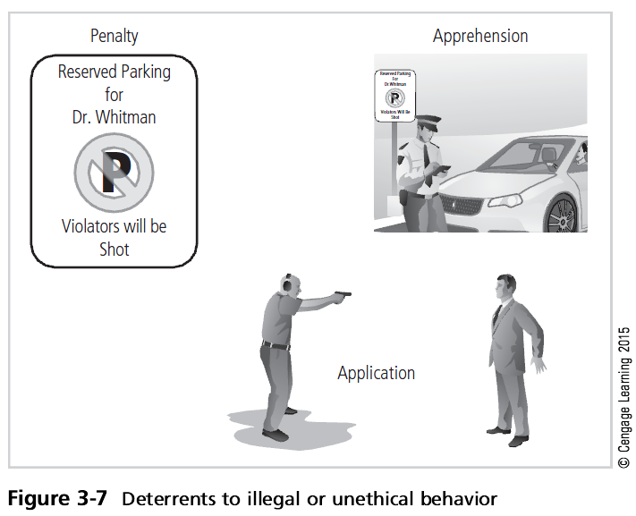
Principles of Information Security, Fifth Edition

Slide 38
Codes of Ethics and Professional Organizations
Many professional organizations have established codes of conduct/ethics.
Codes of ethics can have a positive effect; unfortunately, many employers do not encourage joining these professional organizations.
Responsibility of security professionals is to act ethically and according to the policies of the employer, the professional organization, and the laws of society.
Principles of Information Security, Fifth Edition
Notes:
Codes Of Ethics, Certifications, and Professional Organizations
A number of professional organizations have established codes of conduct and/or codes of ethics that members are expected to follow.
Codes of ethics can have a positive effect on an individual’s judgment regarding computer use.
Unfortunately, having a code of ethics is not enough, because many employers do not encourage their employees to join these professional organizations.
It is the responsibility of security professionals to act ethically and according to the policies and procedures of their employer, their professional organization, and the laws of society.

Slide 39
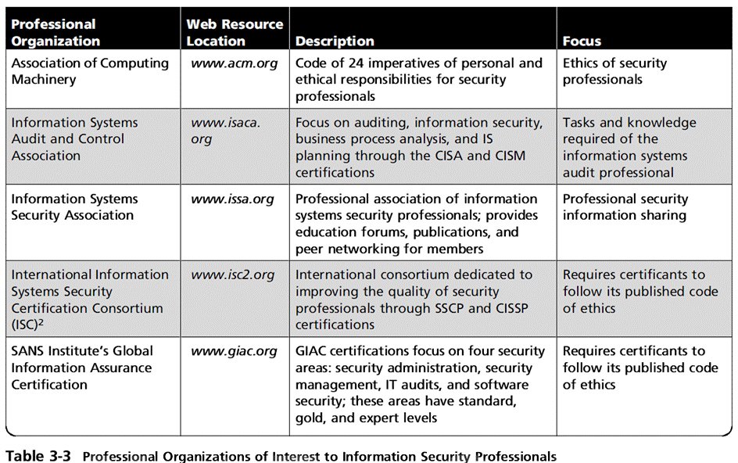
Principles of Information Security, Fifth Edition

Slide 40
Major IT Professional Organizations
Association of Computing Machinery (ACM)‏
  Established in 1947 as “the world’s first educational and scientific computing society”
  Code of ethics contains references to protecting information confidentiality, causing no harm, protecting others’ privacy, and respecting others’ intellectual property and copyrights.
Principles of Information Security, Fifth Edition
Notes:
Association of Computing Machinery
The ACM (www.acm.org) is a respected professional society, originally established in 1947 as “the world's first educational and scientific computing society.”
The ACM’s code of ethics requires members to perform their duties in a manner befitting an ethical computing professional.
The code contains specific references to protecting the confidentiality of information, causing no harm, protecting the privacy of others, and respecting the intellectual property and copyrights of others.

Slide 41
Major IT Professional Organizations (cont’d)
International Information Systems Security Certification Consortium, Inc. (ISC)²
  Nonprofit organization focusing on the development and implementation of information security certifications and credentials
  Code is primarily designed for the information security professionals who have certification from (ISC)².
  Code of ethics focuses on four mandatory canons.
Principles of Information Security, Fifth Edition
Notes:
International Information Systems Security Certification Consortium
The (ISC)² (www.isc2.org) is a nonprofit organization that focuses on the development and implementation of information security certifications and credentials.
The code of ethics put forth by (ISC)² is primarily designed for information security professionals who have earned a certification from (ISC)².
This code focuses on four mandatory canons:
Protect society, the commonwealth, and the infrastructure;
Act honorably, honestly, justly, responsibly, and legally;
Provide diligent and competent service to principals; and
Advance and protect the profession.

Slide 42
Major IT Professional Organizations (cont’d)
SANS (originally System Administration, Networking, and Security Institute)
  Professional organization with a large membership dedicated to the protection of information and systems
  SANS offers a set of certifications called Global Information Assurance Certification (GIAC)‏.
Principles of Information Security, Fifth Edition
Notes:
System Administration, Networking, and Security Institute
SANS (formerly System Administration, Networking, and Security Institute)
Professional organization with a large membership dedicated to protection of information and systems
SANS offers set of certifications called Global Information Assurance Certification (GIAC)‏

Slide 43
Major IT Professional Organizations (cont’d)
ISACA (originally Information Systems Audit and Control Association)‏
  Professional association with focus on auditing, control, and security
  Concentrates on providing IT control practices and standards
  ISACA has a code of ethics for its professionals.
Principles of Information Security, Fifth Edition
Notes:
Information Systems Audit and Control Association
The Information Systems Audit and Control Association or ISACA (www.isaca.org) is a professional association with a focus on auditing, control, and security.
Although it does not focus exclusively on information security, the Certified Information Systems Auditor or CISA certification does contain many information security components.
The ISACA also has a code of ethics for its professionals. It requires many of the same high standards for ethical performance as the other organizations and certifications.

Slide 44
Major IT Professional Organizations (cont’d)
Information Systems Security Association (ISSA)‏
  Nonprofit society of information security (IS) professionals
  Primary mission to bring together qualified IS practitioners for information exchange and educational development
  Promotes code of ethics similar to (ISC)², ISACA, and ACM
Principles of Information Security, Fifth Edition
Notes:
Information Systems Security Association (ISSA)‏
Nonprofit society of information security (IS) professionals
Primary mission to bring together qualified IS practitioners for information exchange and educational development
Promotes code of ethics similar to (ISC)², ISACA, and ACM

Slide 45
Key U.S. Federal Agencies
Department of Homeland Security (DHS)
  Made up of five directorates, or divisions
  Mission is to protect the citizens as well as the physical and informational assets of the United States
  US-CERT provides mechanisms to report phishing and malware.
U.S. Secret Service
  In addition to protective services, it is charged with safeguarding the nation’s financial infrastructure and payments system to preserve integrity of the economy.
Principles of Information Security, Fifth Edition
Notes:
KEY U.S. FEDERAL AGENCIES
Department of Homeland Security (DHS)
Made up of five directorates, or divisions
Mission is to protect the citizens as well as the physical and informational assets of the US
US-CERT provides mechanisms to report phishing and malware
U.S. Secret Service
In addition to protective services, charged with safeguarding nation’s financial infrastructure and payments system to preserve integrity of economy

Slide 46
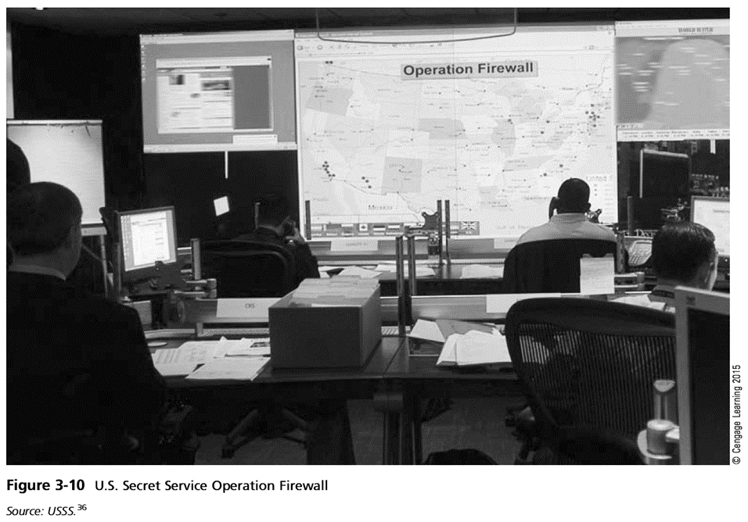
Principles of Information Security, Fifth Edition

Slide 47
Key U.S. Federal Agencies (cont’d)
Federal Bureau of Investigation
  Primary law enforcement agency; investigates traditional crimes and cybercrimes
  Key priorities include computer/network intrusions, identity theft, and fraud
  Federal Bureau of Investigation’s National InfraGard Program
    Maintains an intrusion alert network
    Maintains a secure Web site for communication about suspicious activity or intrusions
    Sponsors local chapter activities
    Operates a help desk for questions
Principles of Information Security, Fifth Edition
Notes:
Federal Bureau of Investigation
Primary law enforcement agency; investigates traditional crimes and cybercrimes
Key priorities include computer/network intrusions, identity theft, and fraud
Federal Bureau of Investigation’s National InfraGard Program
Maintains an intrusion alert network
Maintains a secure Web site for communication about suspicious activity or intrusions
Sponsors local chapter activities
Operates a help desk for questions

Slide 48
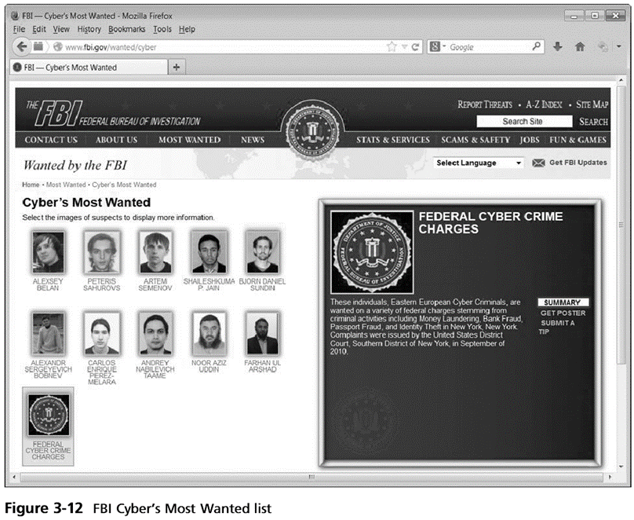
Principles of Information Security, Fifth Edition

Slide 49
Key U.S. Federal Agencies (cont’d)
National Security Agency (NSA)
  Is the nation’s cryptologic organization
  Responsible for signal intelligence and information assurance (security)
  Information Assurance Directorate (IAD) is responsible for the protection of systems that store, process, and transmit information of high national value.
Principles of Information Security, Fifth Edition
Notes:
National Security Agency (NSA)
Is the Nation’s cryptologic organization
Responsible for signal intelligence and information assurance (security)
Information Assurance Directorate (IAD) responsible for protection of systems that store, process, and transmit information of high national value

Slide 50
Summary
Laws: rules that mandate or prohibit certain behavior in society; drawn from ethics
Ethics: define socially acceptable behaviors, based on cultural mores (fixed moral attitudes or customs of a particular group)‏
Types of law: civil, criminal, private, public
Principles of Information Security, Fifth Edition

Slide 51
Summary (cont’d)
Relevant U.S. laws:
  Computer Fraud and Abuse Act of 1986 (CFA Act)‏
  National Information Infrastructure Protection Act of 1996
  USA PATRIOT Act of 2001
  USA PATRIOT Improvement and Reauthorization Act
  Computer Security Act of 1987
  Title 18, U.S.C. § 1028
Principles of Information Security, Fifth Edition

Slide 52
Summary (cont’d)
Many organizations have codes of conduct and/or codes of ethics.
Organization increases liability if it refuses to take measures known as due care.
Due diligence requires that organizations make a valid effort to protect others and continually maintain that effort.
Principles of Information Security, Fifth Edition

